Slide 1
Adversarial Search
Chapter 5

Slide 2
A tree with branching factor 2 and depth 4, has the following values for its leaves: 5, 15, 10, 2, 7, 8, 5, 3, 4, 5, 15, 9, 15, 23, 12, 4
Draw the described tree.
Find the MinMax value of the tree.
Apply Alpha-Beta pruning showing the nodes that will not be evaluated.
Notes:
a.
Max ┌───────────▲───────────┐
│ │
Min ┌─────▼-────┐ ┌─────▼-────┐
│ │ │ │
Max ┌──▲──┐ ┌──▲──┐ ┌──▲──┐ ┌──▲──┐
│ │ │ │ │ │ │ │
Min ┌▼┐ ┌▼┐ ┌▼┐ ┌▼┐ ┌▼┐ ┌▼┐ ┌▼┐ ┌▼┐
│ │ │ │ │ │ │ │ │ │ │ │ │ │ │ │
Leaf 5 15 10 2 7 8 5 3 4 5 15 9 15 23 12 4
b.
Max 9
┌───────────▲───────────┐
Min 5 9
┌─────▼-────┐ ┌─────▼-────┐
Max 5 7 9 15
┌──▲──┐ ┌──▲──┐ ┌──▲──┐ ┌──▲──┐
Min 5 2 7 3 4 9 15 4
┌▼┐ ┌▼┐ ┌▼┐ ┌▼┐ ┌▼┐ ┌▼┐ ┌▼┐ ┌▼┐
Leaf 5 15 10 2 7 8 5 3 4 5 15 9 15 23 12 4
Minimax Algorithm:
Function max_search(state):
If is_terminal(state): return value_of(state)
value = -∞
For action in get_actions(state, max_player):
child = get_successor(state, max_player, action)
value = max(Value, min_search(child))
Return value
Function min_search(state):
If is_terminal(state): return value_of(state)
value = ∞
For action in get_actions(state, min_player):
child = get_successor(state, min_player, action)
value = min(Value, max_search(child))
Return value
Root_Value = max_search(initial_state)
Notes:
The search traverses the tree in a depth first search manner. While it is possible to traverse it in a breadth first manner, it would both complicate the implementation and exponentially increase the memory requirements.
In the actual implementation of minimax search, we also return the best action to tell the agent what to do.
C.
Alpha-Beta Algorithm:
Function max_search(state, alpha, beta):
If is_terminal(state): return value_of(state)
value = -∞
For action in get_actions(state, max_player):
child = get_successor(state, max_player, action)
value = max(Value, min_search(child, alpha, beta))
If value >= beta: break
alpha = max(value, alpha)
Return value
Function min_search(state):
If is_terminal(state): return value_of(state)
value = ∞
For action in get_actions(state, min_player):
child = get_successor(state, min_player, action)
value = min(Value, max_search(child, alpha, beta))
If value <= alpha: break
beta = min(value, beta)
Return value
Root_Value = max_search(initial_state, -∞, ∞)
Let’s name the nodes:
Max S
┌───────────▲───────────┐
Min A B
┌─────▼-────┐ ┌─────▼-────┐
Max C D E F
┌──▲──┐ ┌──▲──┐ ┌──▲──┐ ┌──▲──┐
Min G H I J K L M N
┌▼┐ ┌▼┐ ┌▼┐ ┌▼┐ ┌▼┐ ┌▼┐ ┌▼┐ ┌▼┐
Leaf 5 15 10 2 7 8 5 3 4 5 15 9 15 23 12 4
Trace:
Call max_search(S, -∞, ∞)
Value = -∞
Call min_search(A, -∞, ∞)
Value = ∞
Call max_search(C, -∞, ∞)
Value = -∞
Call min_search(G, -∞, ∞)
Value = ∞
Call max_search(Leaf:5, -∞, ∞), Returns 5
Value = min(∞, 5) = 5
If 5 <= -∞: break (NO)
Beta = min(∞, 5) = 5
Call max_search(Leaf:15, -∞, 5), Returns 15
Value = min(5, 15) = 5
If 5 <= -∞: break (NO)
Beta = min(5, 5) = 5
Return 5
Value = max(-∞, 5) = 5
If 5 >= ∞: break (NO)
Alpha = max(-∞, 5) = 5
Call min_search(H, 5, ∞)
Value = ∞
Call max_search(Leaf:10, 5, ∞), Returns 10
Value = min(∞, 10) = 10
If 10 <= 5: break (NO)
Beta = min(∞, 10) = 10
Call max_search(Leaf:2, 5, 10), Returns 2
Value = min(10, 2) = 2
If 2 <= 5: break (YES)
Return 2
Value = max(5, 2) = 5
If 5 >= ∞: break (NO)
Alpha = max(-∞, 5) = 5
Return 5
Value = min(∞, 5) = 5
If 5 <= -∞: break (NO)
Beta = min(∞, 5) = 5
Call max_search(D, -∞, 5)
Value = -∞
Call min_search(I, -∞, 5)
Value = ∞
Call max_search(Leaf:7, -∞, 5), Returns 7
Value = min(∞, 7) = 7
If 7 <= -∞: break (NO)
Beta = min(5, 7) = 5
Call max_search(Leaf:8, -∞, 5), Returns 8
Value = min(7, 8) = 7
If 7 <= -∞: break (NO)
Beta = min(5, 7) = 5
Return 7
Value = max(-∞, 7) = 7
If 7 >= 5: break (YES)
Return 7
Value = min(5, 7) = 5
If 5 <= -∞: break (NO)
Beta = min(5, 5) = 5
Return 5
Value = max(-∞, 5) = 5
If 5 >= ∞: break (NO)
Alpha = max(-∞, 5) = 5
Call min_search(B, 5, ∞)
Value = ∞
Call max_search(E, 5, ∞)
Value = -∞
Call min_search(K, 5, ∞)
Value = ∞
Call max_search(Leaf:4, 5, ∞), Returns 4
Value = min(∞, 4) = 4
If 4 <= 5: break (YES)
Return 4
Value = max(-∞, 4) = 4
If 4 >= ∞: break (NO)
Alpha = max(-∞, 4) = 4
Call min_search(L, 5, ∞)
Value = ∞
Call max_search(Leaf:15, 5, ∞), Returns 15
Value = min(∞, 15) = 15
If 15 <= 5: break (NO)
Beta = min(∞, 15) = 15
Call max_search(Leaf:9, 5, 15), Returns 9
Value = min(15, 9) = 9
If 9 <= 5: break (NO)
Beta = min(15, 9) = 9
Return 9
Value = max(4, 9) = 9
If 9 >= ∞: break (NO)
Alpha = max(4, 9) = 9
Return 9
Value = min(∞, 9) = 9
If 9 <= 5: break (NO)
Beta = min(∞, 9) = 9
Call max_search(F, 5, 9)
Value = -∞
Call min_search(M, 5, 9)
Value = ∞
Call max_search(Leaf:15, 5, 9), Returns 15
Value = min(∞, 15) = 15
If 15 <= 5: break (NO)
Beta = min(9, 15) = 9
Call max_search(Leaf:23, 5, 9), Returns 23
Value = min(15, 23) = 15
If 15 <= 5: break (NO)
Beta = min(9, 15) = 9
Return 15
Value = max(-∞, 15) = 15
If 15 >= 9: break (YES)
Return 15
Value = min(9, 15) = 9
If 9 <= 5: break (NO)
Beta = min(9, 9) = 9
Return 9
Value = max(5, 9) = 9
If 9 >= ∞: break (NO)
Alpha = max(5, 9) = 9
Return 9
Final Result 9
Max S
┌───────────▲───────────┐
Min A B
┌─────▼-────┐ ┌─────▼-────┐
Max C D E F
┌──▲──┐ ┌──▲──┐ ┌──▲──┐ ┌──▲──┐
Min G H I J K L M N
┌▼┐ ┌▼┐ ┌▼┐ ┌▼┐ ┌▼┐ ┌▼┐ ┌▼┐ ┌▼┐
Leaf 5 15 10 2 7 8 5 3 4 5 15 9 15 23 12 4

Slide 3
a.
5
15
10
2
7
8
5
3
4
5
15
9
15
23
12
4

Slide 4
b.
9
5
9
5
7
9
15
5
2
7
3
4
9
15
4
5
15
10
2
7
8
5
3
4
5
15
9
15
23
12
4

Slide 5
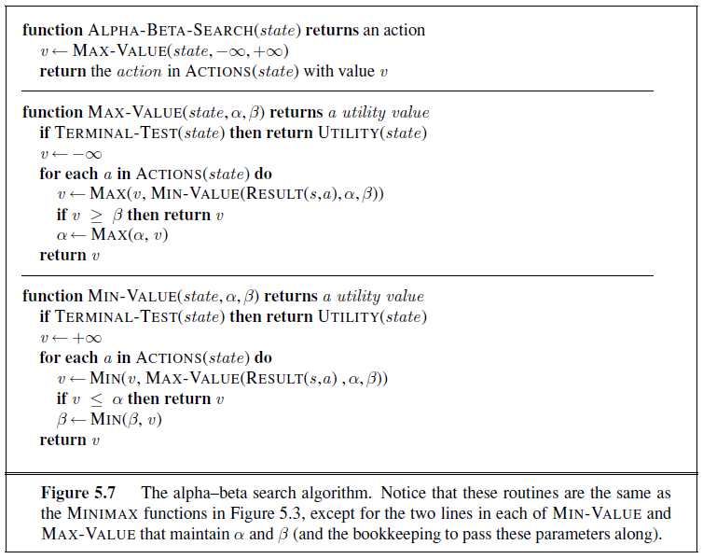

Slide 6
c.
𝛼, β = -∞, ∞
Starting from the root, we traverse the tree in a depth-first order and pass the alpha and beta to each call.
v=-∞
5
15
10
2
7
8
5
3
4
5
15
9
15
23
12
4

Slide 7
c.
𝛼, β = -∞, ∞
v=-∞
-∞, ∞
∞
5
15
10
2
7
8
5
3
4
5
15
9
15
23
12
4

Slide 8
c.
𝛼, β = -∞, ∞
v=-∞
-∞, ∞
∞
-∞, ∞
-∞
5
15
10
2
7
8
5
3
4
5
15
9
15
23
12
4

Slide 9
c.
𝛼, β = -∞, ∞
Note the the initial values for maximizing & minimizing nodes are negative & positive infinity respectively
v=-∞
-∞, ∞
∞
-∞, ∞
-∞
-∞, ∞
∞
5
15
10
2
7
8
5
3
4
5
15
9
15
23
12
4

Slide 10
c.
𝛼, β = -∞, ∞
For minimizing nodes:
value = min(value, child_value)
If value <= alpha: break
Beta = min(beta, value)
v=-∞
-∞, ∞
∞
-∞, ∞
-∞
-∞, 5
5
5
15
10
2
7
8
5
3
4
5
15
9
15
23
12
4

Slide 11
c.
𝛼, β = -∞, ∞
For minimizing nodes:
value = min(value, child_value)
If value <= alpha: break
Beta = min(beta, value)
v=-∞
-∞, ∞
∞
-∞, ∞
-∞
-∞, 5
5
5
15
10
2
7
8
5
3
4
5
15
9
15
23
12
4

Slide 12
c.
𝛼, β = -∞, ∞
Then we go up the tree with the value (we don’t take the update alpha & beta with us while going up)
v=-∞
-∞, ∞
∞
5, ∞
5
5
5
15
10
2
7
8
5
3
4
5
15
9
15
23
12
4

Slide 13
c.
𝛼, β = -∞, ∞
v=-∞
-∞, ∞
∞
5, ∞
5
5, ∞
5
∞
5
15
10
2
7
8
5
3
4
5
15
9
15
23
12
4

Slide 14
c.
𝛼, β = -∞, ∞
v=-∞
-∞, ∞
∞
5, ∞
5
5, 10
5
10
5
15
10
2
7
8
5
3
4
5
15
9
15
23
12
4

Slide 15
c.
𝛼, β = -∞, ∞
For minimizing nodes:
value = min(value, child_value)
If value <= alpha: break
beta = min(beta, value)
Since 2 <= 5, we break
v=-∞
-∞, ∞
∞
5, ∞
5
5, 10
5
2
5
15
10
2
7
8
5
3
4
5
15
9
15
23
12
4

Slide 16
c.
𝛼, β = -∞, ∞
v=-∞
-∞, ∞
∞
5, ∞
5
5
2
5
15
10
2
7
8
5
3
4
5
15
9
15
23
12
4

Slide 17
c.
𝛼, β = -∞, ∞
v=-∞
-∞, 5
5
5
5
2
5
15
10
2
7
8
5
3
4
5
15
9
15
23
12
4

Slide 18
c.
𝛼, β = -∞, ∞
v=-∞
-∞, 5
5
-∞, 5
5
-∞
5
2
5
15
10
2
7
8
5
3
4
5
15
9
15
23
12
4

Slide 19
c.
𝛼, β = -∞, ∞
v=-∞
-∞, 5
5
-∞, 5
5
-∞
-∞, 5
5
2
∞
5
15
10
2
7
8
5
3
4
5
15
9
15
23
12
4

Slide 20
c.
𝛼, β = -∞, ∞
v=-∞
-∞, 5
5
-∞, 5
5
-∞
-∞, 5
5
2
7
5
15
10
2
7
8
5
3
4
5
15
9
15
23
12
4

Slide 21
c.
𝛼, β = -∞, ∞
v=-∞
-∞, 5
5
-∞, 5
5
-∞
-∞, 5
5
2
7
5
15
10
2
7
8
5
3
4
5
15
9
15
23
12
4

Slide 22
c.
𝛼, β = -∞, ∞
For maximizing nodes:
value = max(value, child_value)
If value >= beta: break
alpha = max(alpha, value)
Since 7 >= 5, we break
v=-∞
-∞, 5
5
-∞, 5
5
7
5
2
7
5
15
10
2
7
8
5
3
4
5
15
9
15
23
12
4

Slide 23
c.
𝛼, β = -∞, ∞
v=-∞
-∞, 5
5
5
7
5
2
7
5
15
10
2
7
8
5
3
4
5
15
9
15
23
12
4

Slide 24
c.
𝛼, β = 5, ∞
v=5
5
5
7
5
2
7
5
15
10
2
7
8
5
3
4
5
15
9
15
23
12
4

Slide 25
c.
𝛼, β = 5, ∞
v=5
5, ∞
5
∞
5
7
5
2
7
5
15
10
2
7
8
5
3
4
5
15
9
15
23
12
4

Slide 26
c.
𝛼, β = 5, ∞
v=5
5, ∞
5
∞
5, ∞
5
7
-∞
5
2
7
5
15
10
2
7
8
5
3
4
5
15
9
15
23
12
4

Slide 27
c.
𝛼, β = 5, ∞
v=5
5, ∞
5
∞
5, ∞
5
7
-∞
5, ∞
5
2
7
∞
5
15
10
2
7
8
5
3
4
5
15
9
15
23
12
4

Slide 28
c.
𝛼, β = 5, ∞
v=5
5, ∞
5
∞
5, ∞
5
7
-∞
5, ∞
5
2
7
4
5
15
10
2
7
8
5
3
4
5
15
9
15
23
12
4

Slide 29
c.
𝛼, β = 5, ∞
v=5
5, ∞
5
∞
5, ∞
5
7
4
5
2
7
4
5
15
10
2
7
8
5
3
4
5
15
9
15
23
12
4

Slide 30
c.
𝛼, β = 5, ∞
v=5
5, ∞
5
∞
5, ∞
5
7
4
5, ∞
5
2
7
4
∞
5
15
10
2
7
8
5
3
4
5
15
9
15
23
12
4

Slide 31
c.
𝛼, β = 5, ∞
v=5
5, ∞
5
∞
5, ∞
5
7
4
5, 15
5
2
7
4
15
5
15
10
2
7
8
5
3
4
5
15
9
15
23
12
4

Slide 32
c.
𝛼, β = 5, ∞
v=5
5, ∞
5
∞
5, ∞
5
7
4
5, 9
5
2
7
4
9
5
15
10
2
7
8
5
3
4
5
15
9
15
23
12
4

Slide 33
c.
𝛼, β = 5, ∞
v=5
5, ∞
5
∞
9, ∞
5
7
9
5
2
7
4
9
5
15
10
2
7
8
5
3
4
5
15
9
15
23
12
4

Slide 34
c.
𝛼, β = 5, ∞
v=5
5, 9
5
9
5
7
9
5
2
7
4
9
5
15
10
2
7
8
5
3
4
5
15
9
15
23
12
4

Slide 35
c.
𝛼, β = 5, ∞
v=5
5, 9
5
9
5, 9
5
7
9
-∞
5
2
7
4
9
5
15
10
2
7
8
5
3
4
5
15
9
15
23
12
4

Slide 36
c.
𝛼, β = 5, ∞
v=5
5, 9
5
9
5, 9
5
7
9
-∞
5, 9
5
2
7
4
9
∞
5
15
10
2
7
8
5
3
4
5
15
9
15
23
12
4

Slide 37
c.
𝛼, β = 5, ∞
v=5
5, 9
5
9
5, 9
5
7
9
-∞
5, 9
5
2
7
4
9
15
5
15
10
2
7
8
5
3
4
5
15
9
15
23
12
4

Slide 38
c.
𝛼, β = 5, ∞
v=5
5, 9
5
9
5, 9
5
7
9
-∞
5, 9
5
2
7
4
9
15
5
15
10
2
7
8
5
3
4
5
15
9
15
23
12
4

Slide 39
c.
𝛼, β = 5, ∞
v=5
5, 9
5
9
5, 9
5
7
9
15
5
2
7
4
9
15
5
15
10
2
7
8
5
3
4
5
15
9
15
23
12
4

Slide 40
c.
𝛼, β = 5, ∞
v=5
5, 9
5
9
5
7
9
15
5
2
7
4
9
15
5
15
10
2
7
8
5
3
4
5
15
9
15
23
12
4

Slide 41
c.
𝛼, β = 9, ∞
v=9
5
9
5
7
9
15
5
2
7
4
9
15
5
15
10
2
7
8
5
3
4
5
15
9
15
23
12
4

Slide 42
c.
In the end, we were able to solve this problem without evaluating the nodes marked in red; thanks to alpha-beta pruning.
v=9
5
9
5
7
9
15
5
2
7
4
9
15
5
15
10
2
7
8
5
3
4
5
15
9
15
23
12
4

Slide 43
extra.
Assuming that the 2nd player is replaced by a fair coin flip (actions are randomly picked), apply expectimax to this tree.
5
15
10
2
7
8
5
3
4
5
15
9
15
23
12
4

Slide 44
extra.
Random Nodes takes the weighted average of its children. Here the weights are 0.5 & 0.5 since both actions have the same probability.
15.5
8.75
15.5
10
7.5
12
19
10
6
7.5
4
4.5
12
19
8
5
15
10
2
7
8
5
3
4
5
15
9
15
23
12
4

Slide 45
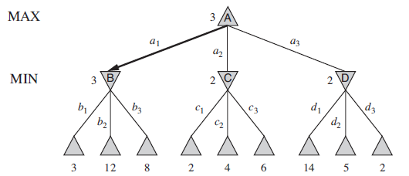
Notes:
Apply Alpha Beta Pruning:
3
Max ┌───────────▲───────────┐
│ │ │
3 2 2
Min ┌──▼-─┐ ┌──▼──┐ ┌──▼──┐
│ │ │ │ │ │ │ │ │
Leafs 3 12 8 2 4 6 14 5 2

Slide 46
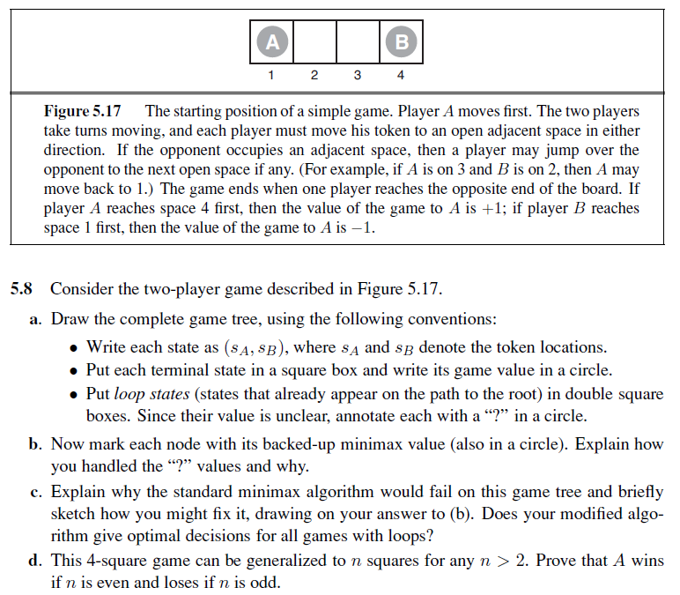
Notes:
a.
▲(1,4) → ▼(2,4) → ▲(2,3) ┮→ ▼(1,3) ┮→ ▲(1,2) → ▼(3,2) ┮→ ▲(3,4) → ▼(2,4)
│ │ │ ?
┕→ ▼(4,3) ┕→ ▲(1,4) ┕→ ▲(3,1)
+1 ? -1
b.
▲(1,4) → ▼(2,4) → ▲(2,3) ┮→ ▼(1,3) ┮→ ▲(1,2) → ▼(3,2) ┮→ ▲(3,4) → ▼(2,4)
+1 +1 +1 │ -1 │ -1 -1 │ +1 +1
┕→ ▼(4,3) ┕→ ▲(1,4) ┕→ ▲(3,1)
+1 -1 -1
Since there are two possible values only {-1, 1}, we can do:
max( ?, ?) = ?, max( ?, -1) = ?, max( ?, 1) = 1
max(-1, -1) = -1, max(-1, 1) = 1
max( 1, 1) = 1
min( ?, ?) = ?, min( ?, -1) = -1, min( ?, 1) = ?
min(-1, -1) = -1, min(-1, 1) = -1
min( 1, 1) = 1
c. The standard minimax algorithm would get stuck in an infinite loop.
One way to fix it is to store states along the path to the root and whenever we visit a loop node, we return with “?” and handle it as shown in “b”.
This will not handle all cases since we may end up propagating “?” to the root and fail to get an answer. Also we have no way to handle “?” if the known values are not binary (not just -1 & 1).
d.
This question is a little tricky. One approach is a proof by induction on the size of the game. Clearly, the base case n=3 is a loss for A and the base case n=4 is a win for A. For any n > 4, the initial moves are the same: A and B both move one step towards each other. Now, we can see that they are engaged in a subgame of size n − 2 on the squares [2, . . . , n − 1], except that there is an extra choice of moves on squares 2 and n − 1. Ignoring this for a moment, it is clear that if the “n − 2” is won for A, then A gets to the square n − 1 before B gets to square 2 (by the definition of winning) and therefore gets to n before B gets to 1, hence the “n” game is won for A. By the same line of reasoning, if “n − 2” is won for B then “n” is won for B. Now, the presence of the extra moves complicates the issue, but not too much. First, the player who is slated to win the subgame [2, . . . , n − 1] never moves back to his home square. If the player slated to lose the subgame does so, then it is easy to show that he is bound to lose the game itself—the other player simply moves forward and a subgame of size n − 2k is played one step closer to the loser’s home square.

Slide 47
▲(1,4)
▼(2,4)
▲(2,3)
▼(1,3)
▼(4,3)
+1
▲(1,2)
▲(1,4)
?
▼(3,2)
▲(3,4)
▲(3,1)
-1
▼(2,4)
?

Slide 48
+1
▲(1,4)
▼(2,4)
+1
▲(2,3)
+1
▼(4,3)
+1
▼(1,3)
-1
▲(1,2)
-1
▲(1,4)
?
▼(3,2)
?
▲(3,4)
-1
▲(3,1)
-1
Since the possible values are only -1 and +1, we know that ? can either hold -1 or +1 and nothing else.
So min(-1,?)=-1 and max(1,?)=1
▼(2,4)
?

Slide 49
+1
▲(1,4)
▼(2,4)
+1
▲(2,3)
+1
▼(4,3)
+1
▼(1,3)
-1
▲(1,2)
-1
▲(1,4)
+1
▼(3,2)
+1
▲(3,4)
-1
▲(3,1)
-1
We can even go back and update the rest of the tree to remove all “?” if needed.
▼(2,4)
+1

Slide 50
More Questions

Slide 51
extra.
Assuming that the result of each action is randomly selected between two states (e.g. the result is affected by a fair coin flip), apply expectiminimax to this tree.
5
15
10
2
7
8
5
3
4
5
15
9
15
23
12
4

Slide 52
extra.
Random Nodes takes the weighted average of its children. Here the weights are 0.5 & 0.5 since both actions have the same probability.
6.25
5
6.25
6
4
4.5
8
10
6
7.5
4
4.5
12
19
8
5
15
10
2
7
8
5
3
4
5
15
9
15
23
12
4

Slide 53
extra.
Apply Alpha Beta Pruning to this tree
10
11
8
9
14
15
12
13
2
3
0
1
6
7
4
5

Slide 54
extra.
𝛼, β = -∞, ∞
v=-∞
10
11
8
9
14
15
12
13
2
3
0
1
6
7
4
5

Slide 55
extra.
𝛼, β = -∞, ∞
v=-∞
-∞, ∞
∞
10
11
8
9
14
15
12
13
2
3
0
1
6
7
4
5

Slide 56
extra.
𝛼, β = -∞, ∞
v=-∞
-∞, ∞
∞
-∞, ∞
-∞
10
11
8
9
14
15
12
13
2
3
0
1
6
7
4
5

Slide 57
extra.
𝛼, β = -∞, ∞
v=-∞
-∞, ∞
∞
-∞, ∞
-∞
-∞, ∞
∞
10
11
8
9
14
15
12
13
2
3
0
1
6
7
4
5

Slide 58
extra.
𝛼, β = -∞, ∞
v=-∞
-∞, ∞
∞
-∞, ∞
-∞
-∞, 10
10
10
11
8
9
14
15
12
13
2
3
0
1
6
7
4
5

Slide 59
extra.
𝛼, β = -∞, ∞
v=-∞
-∞, ∞
∞
-∞, ∞
-∞
-∞, 10
10
10
11
8
9
14
15
12
13
2
3
0
1
6
7
4
5

Slide 60
extra.
𝛼, β = -∞, ∞
v=-∞
-∞, ∞
∞
10, ∞
10
10
11
8
9
14
15
12
13
2
3
0
1
6
7
4
5

Slide 61
extra.
𝛼, β = -∞, ∞
v=-∞
-∞, ∞
∞
10, ∞
10
10, ∞
-∞
10
11
8
9
14
15
12
13
2
3
0
1
6
7
4
5

Slide 62
extra.
𝛼, β = -∞, ∞
v=-∞
-∞, ∞
∞
10, ∞
10
10, ∞
8
10
11
8
9
14
15
12
13
2
3
0
1
6
7
4
5

Slide 63
extra.
𝛼, β = -∞, ∞
v=-∞
-∞, ∞
∞
10, ∞
10
10
11
8
9
14
15
12
13
2
3
0
1
6
7
4
5

Slide 64
extra.
𝛼, β = -∞, ∞
v=-∞
-∞, 10
10
10
11
8
9
14
15
12
13
2
3
0
1
6
7
4
5

Slide 65
extra.
𝛼, β = -∞, ∞
v=-∞
-∞, 10
10
-∞, 10
-∞
10
11
8
9
14
15
12
13
2
3
0
1
6
7
4
5

Slide 66
extra.
𝛼, β = -∞, ∞
v=-∞
-∞, 10
10
-∞, 10
-∞
-∞, 10
∞
10
11
8
9
14
15
12
13
2
3
0
1
6
7
4
5

Slide 67
extra.
𝛼, β = -∞, ∞
v=-∞
-∞, 10
10
-∞, 10
-∞
-∞, 10
14
10
11
8
9
14
15
12
13
2
3
0
1
6
7
4
5

Slide 68
extra.
𝛼, β = -∞, ∞
v=-∞
-∞, 10
10
-∞, 10
-∞
-∞, 10
14
10
11
8
9
14
15
12
13
2
3
0
1
6
7
4
5

Slide 69
extra.
𝛼, β = -∞, ∞
v=-∞
-∞, 10
10
-∞, 10
14
10
11
8
9
14
15
12
13
2
3
0
1
6
7
4
5

Slide 70
extra.
𝛼, β = -∞, ∞
v=-∞
-∞, 10
10
10
11
8
9
14
15
12
13
2
3
0
1
6
7
4
5

Slide 71
extra.
𝛼, β = 10, ∞
v=10
10
11
8
9
14
15
12
13
2
3
0
1
6
7
4
5

Slide 72
extra.
𝛼, β = 10, ∞
v=10
10, ∞
∞
10
11
8
9
14
15
12
13
2
3
0
1
6
7
4
5

Slide 73
extra.
𝛼, β = 10, ∞
v=10
10, ∞
∞
10, ∞
-∞
10
11
8
9
14
15
12
13
2
3
0
1
6
7
4
5

Slide 74
extra.
𝛼, β = 10, ∞
v=10
10, ∞
∞
10, ∞
-∞
10, ∞
∞
10
11
8
9
14
15
12
13
2
3
0
1
6
7
4
5

Slide 75
extra.
𝛼, β = 10, ∞
v=10
10, ∞
∞
10, ∞
-∞
10, ∞
2
10
11
8
9
14
15
12
13
2
3
0
1
6
7
4
5

Slide 76
extra.
𝛼, β = 10, ∞
v=10
10, ∞
∞
10, ∞
2
10
11
8
9
14
15
12
13
2
3
0
1
6
7
4
5

Slide 77
extra.
𝛼, β = 10, ∞
v=10
10, ∞
∞
10, ∞
2
10, ∞
∞
10
11
8
9
14
15
12
13
2
3
0
1
6
7
4
5

Slide 78
extra.
𝛼, β = 10, ∞
v=10
10, ∞
∞
10, ∞
2
10, ∞
0
10
11
8
9
14
15
12
13
2
3
0
1
6
7
4
5

Slide 79
extra.
𝛼, β = 10, ∞
v=10
10, ∞
∞
10, ∞
2
10
11
8
9
14
15
12
13
2
3
0
1
6
7
4
5

Slide 80
extra.
𝛼, β = 10, ∞
v=10
10, ∞
2
10
11
8
9
14
15
12
13
2
3
0
1
6
7
4
5

Slide 81
extra.
𝛼, β = 10, ∞
v=10
10
11
8
9
14
15
12
13
2
3
0
1
6
7
4
5

Slide 82
extra.
v=10
10
11
8
9
14
15
12
13
2
3
0
1
6
7
4
5

Slide 83
NEXT WEEK
QUIZ on “GAMES”

